Slide 1
L32-Radiation dosimetry& Physics of Diagnostic X-rays

Slide 2
Radiation dosimetry is the quantitative description of the effect of radiation on living tissue.
The absorbed dose of radiation is the energy delivered to the tissue per unit mass.
Used of Absorbed dose
1.The calculation of dose uptake in living tissue in both radiation protection (reduction of harmful effects), and radiology (potential beneficial effects for example in cancer treatment).
2.It is also used to directly compare the effect of radiation on inanimate matter.
The biological effect of the absorbed dose in tissue cells depends on the type of radiation.

Slide 3
The SI unit of the absorbed dose is the Joule/kilogram or the gray (Gy)):1Gy = 1J/kg)
other unit
The rad:
1Gy = 100 rad.
The units Sievert (Sv ,( and rem: (röntgen equivalent man: (
D_{equiv}(Sv) = RBE x D_{abs}( Gy(
D_{equiv})rem) =RBE x D_{abs}) rad)
With 1 Gy = 100 rad, we have 1Sv = 100rem.
The unit of the RBE is Sv/Gy = rem/rad

Slide 4
QF is used because some types of radiation, such as Alpha Particles , are more biologically damaging internally than other types such as the Beta Particle .
Low energy (E_{max} < 0.03 MeV) particles have a QF of 1.7 which reflects their inability to travel far in biological tissues and their resulting tendency to dissipate all their energy locally and therefore to cause greater biological damage.
Photons and beta particles have a low linear energy transfer coefficient(LET), meaning that they ionize atoms in the tissue that are spaced by several hundred nanometers (several tenths of a micrometer) apart, along their path
Effective radiation dose, a number that provides an estimation of total danger to the whole organism, as a result of the radiation dose to part of the body.

Slide 5
The oxygen enhancement ratio (OER)
OER : is the ratio of doses under hypoxic to aerated conditions that produce the same biologic effect. Or
OER detrimental effect of ionizing radiation due to the presence of oxygen.
The presence or absence of molecular oxygen dramatically influences the biologic effect of x-rays.
Oxygen presence (aerated cells) increases radiation effectiveness for cell killing.
Lack of oxygen (hypoxic cells) results in more radio resistant cells.
ORE = $\frac{radiation doses in hypoxia}{radiation doses in air}$
The maximum OER depends mainly on the ionizing density or LET of the radiation.

Slide 6
Radiation with higher LET and higher relative biological effectiveness (RBE) have a lower OER in mammalian cell tissues .
The value of the maximum OER varies from about 1-4.
The maximum OER ranges from about 2-4 for low-LET radiations such as X-rays, beta particles and gamma rays,
Whereas the OER is unity(=1) for high-LET radiations such as low energy alpha particles.

Slide 7
Uses in medicine
The effect is used in medical physics to increase the effect of radiation therapy in oncology treatments.
Additional oxygen abundance creates additional free radicals(superoxide O₂⁻ , hydrogen peroxide H₂O₂ ) and increases the damage to the target tissue(DNA damage).
In solid tumors the inner parts become less oxygenated than normal tissue and up to three times higher dose is needed to achieve the same tumor control probability as in tissue with normal oxygenation.

Slide 8
Radiation therapy (also called radiotherapy)
Is a cancer treatment that uses high doses of radiation to kill cancer cells and shrink tumors. At low doses, radiation is used in x-rays to see inside body, as with x-rays of teeth or broken bones.
Radiation therapy may be curative in a number of types of cancer if they localized to one area of the body.
It may also be used as part of adjuvant therapy, to prevent tumor recurrence after surgery to remove a primary malignant tumor (for example, early stages of breast cancer)
Radiation therapy is synergistic with chemotherapy, and has been used before, during, and after chemotherapy in susceptible cancers. The subspecialty of oncology concerned with radiotherapy is called radiation oncology.

Slide 9
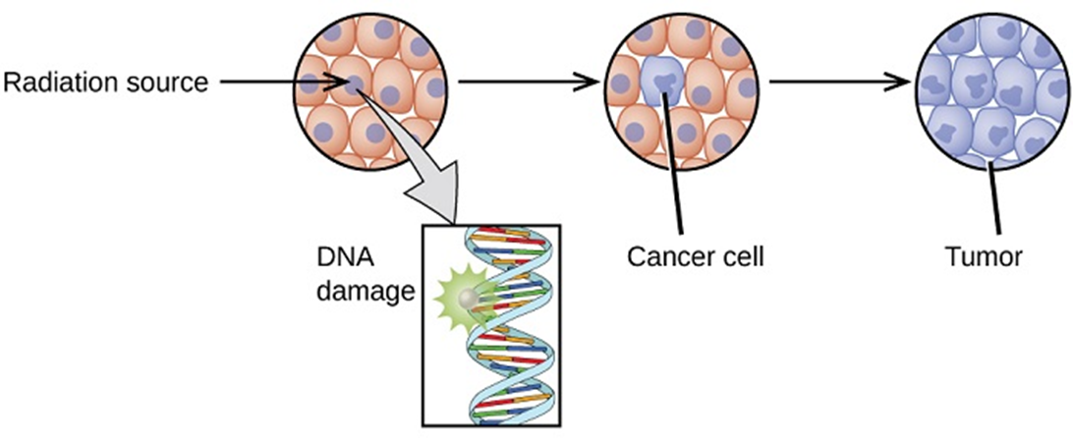
Radiation therapy is commonly applied to the cancerous tumor because of its ability to control cell growth.
Ionizing radiation works by damaging the DNA of cancerous tissue leading to cellular death.
To spare normal tissues (such as skin or organs which radiation must pass through to treat the tumor), shaped radiation beams are aimed from several angles of exposure to intersect at the tumor, providing a much larger absorbed dose there than in the surrounding, healthy tissue.

Slide 10
Types of radiation therapy
There are two main types of radiation therapy, external beam and internal.
The type of radiation therapy that patient may have depends on many factors, including:
The type of cancer
The size of the tumor
The tumor’s location in the body
How close the tumor is to normal tissues that are sensitive to radiation
General health and medical history
Whether the patient will have other types of cancer treatment
Other factors, such as age and other medical conditions

Slide 11
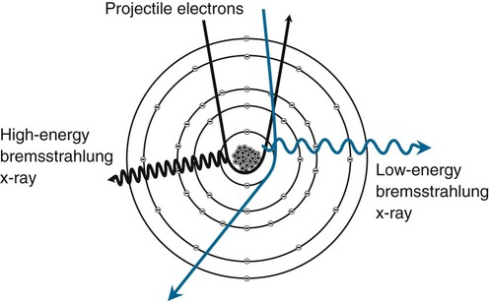
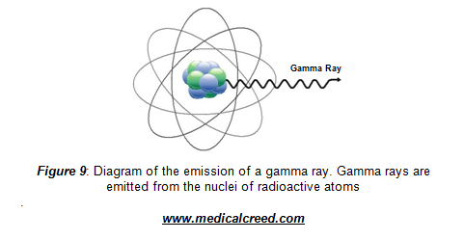
Physics of Diagnostic X-rays
What are x-ray
X-rays and gamma rays are both forms of ionising radiation and are both are forms of electromagnetic radiation, but they differ in their source of origin.
X-rays are produced through interactions in electron shells.
Gamma rays are produced in the nucleus.
X-ray are electromagnetic radiation of exactly the same nature as light but of very much shorter wavelength.

Slide 12
Unit of measurement
Unit of measurement in x-ray region is Angstrom Aº and nm.
1 Aº = 10⁻¹⁰ m ,
1nm = 10 Aº = 10⁻⁹ m
X-ray wavelength are in the range 0.5-2.5 Aº.
Wavelength of visible light ~ 6000 Aº

Slide 13
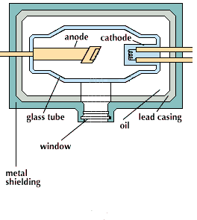
Formation of X-rays
To produce x-rays projectile electrons are accelerated from the negative cathode to the positive anode.

Slide 14
When the electrons from the cathode are accelerated at high voltage to the anode:
The number of electrons accelerated toward the anode depends on the temperature of the filament.
The maximum energy of the X-ray photons produced is determined by the accelerating voltage- kilovolt peak(kVp )
Kilo Voltage Peak (kVp) is the maximum voltage applied across an X-ray tube.
It determines the kinetic energy of the electrons accelerated in the X-ray tube and the peak energy of the X-ray emission spectrum.
The actual voltage across the tube may fluctuate.
An x-ray tube operating at 80 kVp will produce x-ray with spectrum of energies up to maximum of 80 keV(1 keV= 1.6× 10⁻⁹ erg =1.6× 10⁻¹⁶ J)

Slide 15
Diagnostic X-rays typically have energies of 15 to 150 keV,
while visible light photons have energies of 2 to 4 eV
The kVp used for an x-ray study depends on :
1- Thickness of the patient
2- Type of study being done.
X-ray studies of the breast (mammography) are usually done at 25 to 50 kVp,
while some hospitals use up to 350 kVp for chest x-ray
The intensity of the X-ray beam produced when the electrons strike the anode is highly dependent on :
The anode material( the higher the atomic number (Z) of target the more efficiently x-rays are produced).
2. The target material used should also a high melting point since the heat produced when the electrons are stopped in the surface of the target is substantial.

Slide 16
Nearly all x-ray tubes use tungsten target (Z=74, melting point =3400ºC)
The electron current that strike the target is typically 100 to 500 mA, some units even have current of over 1000 mA.
The power put into surface of the target can be quite large.
P=IV
Where I is in amperes ,V in volts and P in watts.
Ex: The power at the target of an X-ray tube with a current of 1A operating at 100 kV (10⁵ V) is :
P=1×10⁵ W or 100 kW
99% of the energy is dissipated as heat (the ratio of energy that goes into X-ray tube to the energy that goes into heat is approximately 10⁻⁹ ZV)
1% is given off as X-rays.

Slide 17
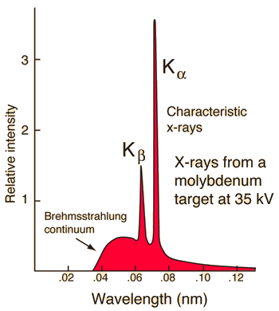
The x-ray radiation is emitted as:
Bremsstrahlung x-ray radiation
and/or
Characteristic x-ray radiation.
1. Bremsstrahlung radiation
While the energy of most of the electron striking the target is dissipated in the form of heat,
The remaining few electrons produce useful x-ray .
Many time one of these electrons gets close enough to the nucleus of a target atom to be diverted from its path and emits an x-ray photon that has some of its energy.
As the electrons pass through the target atom they slow down, with a loss in kinetic energy. This energy is emitted as x-rays.

Slide 18
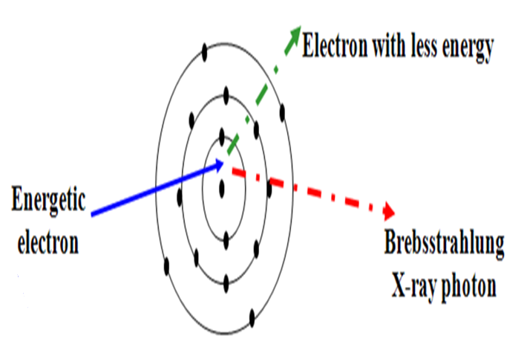
The process is known as bremsstrahlung or “braking energy”.
Approximately 80% of the population of X-rays within the X-ray beam consists of X-rays generated in this way.
The amount of bremsstrahlung produced for a given number of electron striking the anode depends upon two factors:
1- The Z of target, the more protons in the nucleus, the greater the acceleration of electrons
2- The kilovolt peak kVp,the faster the electrons, the more likely they will penetrate into the region of the nucleus

Slide 19
Properties of the Continuous Spectrum bremsstrahlung
Smooth, monotonic function of intensity vs wavelength.
The intensity is zero up to a certain wavelength –Short wavelength limit (${\text{λ}}_{SWL }$ )
Short wavelength limit ( )λ_{SWL}
The electrons transfer all their energy into photon energy
eV=hv_{max}
λ_{SWL} = c/v_{max} =hc/eV =$\frac{12.398 ×{10}^{3}}{V}$
λ_{SWL} =$\frac{12.398 ×{10}^{3}}{V}$
λ in Aº V in volt

Slide 20
The total x-ray energy emitted per second depends on:
The atomic number Z of the target material and
The x-ray tube current.
This total x-ray intensity is given by
I_{total} = A iZV^{m}
A– proportionality constant
i– tube current (measure of the number of electrons per second striking the target)
m– constant ~2

Slide 21
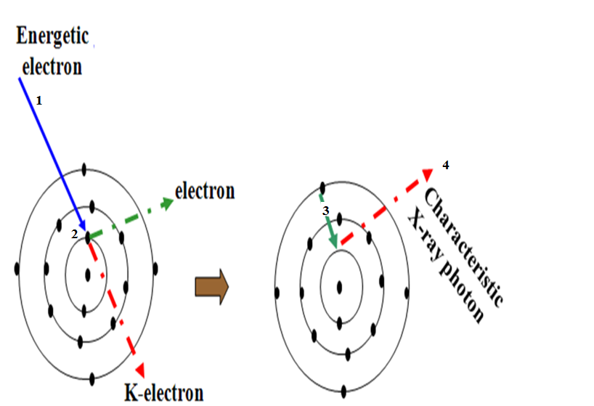
2. Characteristic X-ray generation
Characteristic X-ray generation
When a high energy electron (1) collides with an inner shell electron (2) both are ejected from the tungsten atom leaving a 'hole' in the inner layer. This is filled by an outer shell electron (3) with a loss of energy emitted as an X-ray photon (4).

Slide 22
When another electron fails immediately from the upper energy level such as M or L shell to fill the vacancy, it will give energy in the form of electromagnetic waves (photons) if these in the range of X –ray energy it will show as an X –ray and it is called the characteristic X –ray
If the electrons falls from L shell to k shell it will emit Kα characteristic X-ray
and if it fall from M level to K it will be Kβ characteristic X-ray.
It is called characteristic because it is characteristic of the target element in the energy of the photon produced, which can be seen as lines in the X- ray spectrum.
The Characteristic X-ray Used in mammography

Slide 23
Interactions of X-rays with matter
Interaction in the body begins at the atomic level, Atoms, Molecules, Cells, Tissues, Organ structures.
Photons entering the human body will either: penetrate, absorbed, produce scattered radiation

Slide 24
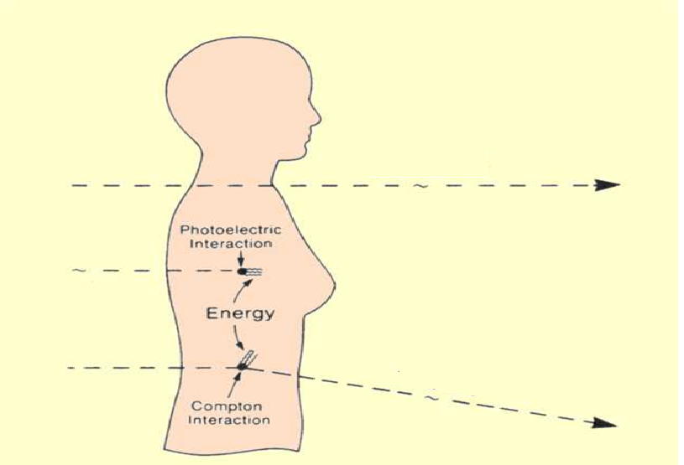
Photons Entering the Human Body Will Either:
Penetrate
Absorbed
Produce Scattered Radiation

Slide 25
Interactions of X-rays with matter
Penetrate (No interaction); X-ray passes completely through tissue and into the image recording device
Complete absorption; X-ray energy is completely absorbed by the tissue. No imaging information results.
Partial absorption with scatter; Scattering involves a partial transfer of energy to tissue, with the resulting scattered X-ray having less energy and a different trajectory.
Scattered radiation tends to degrade image quality and is the primary source of radiation exposure to operator and staff.

Slide 26
HOW X-RAY ARE ABSORBED
-X-ray are not absorbed equally well by all materials,
Heavy elements such as calcium (bone)(high atomic no. Z) are better absorbers (stand out clearly )than light elements such as carbon, oxygen, hydrogen, air (fat, muscle, tumor) are poor absorbers(all absorb about equally well and are thus difficult to distinguish from each other on an x-ray image)

Slide 27
Image formation is dependent on the phenomenon of differential absorption.
Some of the x-rays are absorbed by the tissues such as bone. Other x-rays pass through the tissues and produce the diagnostic image on the film.

Slide 28
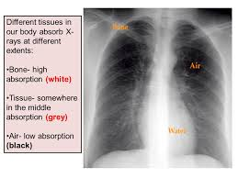
Other x-rays pass into the tissues and are deflected or scattered in the tissues and may exit onto the film.
When x-rays penetrate tissue, they are not homogeneously absorbed; some tissues absorb x-rays more efficiently than others.

Slide 29
If x-ray absorption were uniform, the resulting radiographic image would be grey or white.
The term tissue density is used to describe the degree to which a patient or object absorbs incident x-rays.
In the accompanying radiograph the bone tissue is denser than the adjacent soft tissue.
Penetration of the x-ray beam is dependent on tissue density

Slide 30
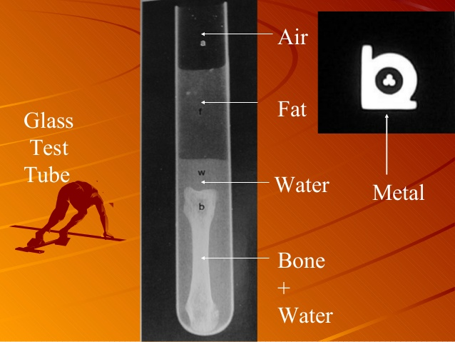

Slide 31
Low density material such as air is represented as black on the final radiograph.
Very dense material such as metal or contrast material is represented as white.
Bodily tissues are varying degrees of grey, depending on density, and thickness.

Slide 32
X-ray absorption
When x-rays encounter any form of matter, they are partly transmitted and partly absorbed.
It was found experimentally that:
I α x
I – intensity x – distance
In differential form :
-dI/I = μdx
Where μ - is linear absorption coefficient (linear attenuation coefficient)

Slide 33
After integration:
I_{x} = I₀ e^{-μ x}
I₀ – incident beam intensity
I_{x} – transmitted beam intensity
Let’s introduce mass absorption coefficient μ/ρ (ρ - density).
It is constant and independent of physical state (solid, liquid, or gas).

Slide 34
Then
I_{x} = I₀ e^{-(μ/ρ)(ρx)}
$μ$ : is the linear attenuation coefficient
$μ$ depends on the energy of x-ray: smaller $μ$ for harder beam
$ρ$ x is area density in grams per ${cm}^{2}$
Mass attenuation coefficient,
$μ_{m}=\frac{μ}{ρ}$

Slide 35
The intensity of a monoenergetic x-ray beam would decrease exponentially,
The linear attenuation coefficient is dependent on energy of x-ray photons ; as the beam becomes harder, it decreases.
Soft x-ray (lower energy): more absorption
Hard x-ray (high energy): less absorption, greater penetration

Slide 36
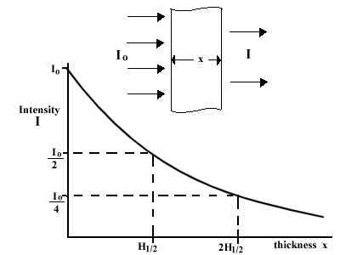
Attenuation of X-rays (The half-value layer (HVL)

Slide 37
Attenuation of X-rays
The half-value layer (HVL) for an x-ray beam is the thickness of the material that makes the X-ray intensity 50 % of its original value.
I_{x} = I₀ e^{-μ x}
0.5=1 × e^{-μ x}
HVL = 2.5 mm for Al
HVL = 0.1 mm for lead, good shielding material for x-ray: 1.5 mm lead plate reduces x-ray energy by a factor of 2¹⁵ ~30000

Slide 38
Example: What is the HVL for a material with attenuation coefficient of 0.4/cm
HVL = $\frac{0.693}{μ}$ =0.693/0.4 = 1.73 cm

Slide 39
The attenuation of the x-ray beam by tissue has been shown to be dependent on:-
1. atomic number (Z) of the tissue.
2. density of the tissue.
3. thickness of the tissue.
4. wavelength of the incident x-ray photon.

Slide 40
Absorption of X-Rays by Tissues
When X-rays pass through materials the energy of the beam is reduced or attenuated by :
1-Photoelectric effect
2-Compton effect (scattering):
3-Pair production
4-Scattering

Slide 41
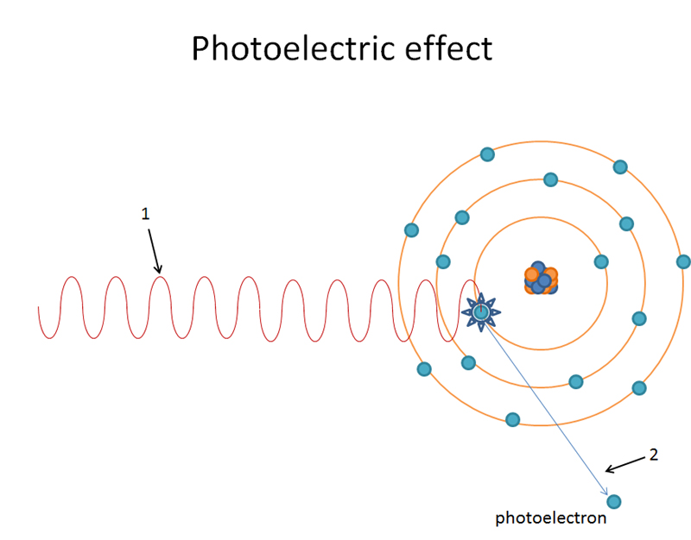
Photoelectric effect:
Photoelectric effect: is the emission of electrons or other free carriers when light(photon) shines on a material.

Slide 42
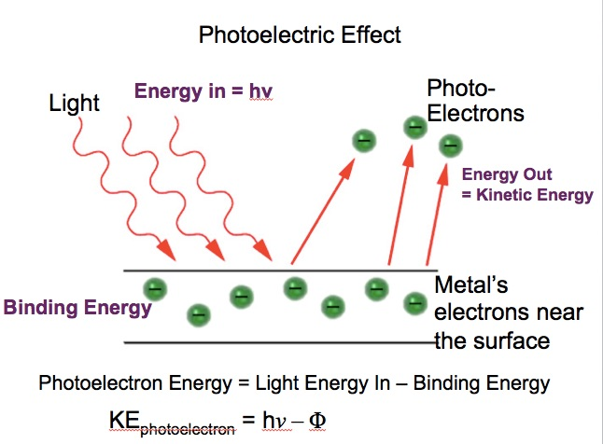
When the incoming x-ray photon with energy (E= h$ν)$. transfers all of its energy to an electron which then escapes from the atom
The photoelectron uses some of its energy ( the binding energy) to get away from the positive nucleus and spend the remainder ripping off (ionizing) surrounding atoms.

Slide 43
Photoelectric effect
Is occur in the intense electric field near the nucleus than in the outer levels of the atom.
Is more common in elements with high Z than in those with low Z.

Slide 44
2.

Slide 45
Compton effect (scattering):
Is the scattering of a photon by a charged particle, usually an electron.
It results in a decrease in energy (increase in wavelength) of the photon (which may be an X-ray or gamma ray photon),
Part of the energy of the photon is transferred to the recoiling electron.

Slide 46
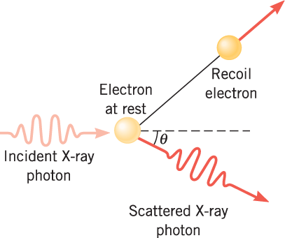
Compton effect (scattering):

Slide 47
Compton effect (scattering):
The x-ray photon can collide with a loosely bound outer electron,
at the collision, the electron receives part of the energy and remainder is given in a Compton (scattered) photon ,which then travels in a direction from that of the original x-ray.

Slide 48
The x-ray has an effective mass m of E/c²
And its momentum is E/c,
we can calculate the energy equivalent of electron mass to be 511 keV, and Compton effect is most likely to occur when the x-ray has this energy

Slide 49
The number of Compton collisions depends only on the number of electrons per cubic centimeter,
which is proportional to the density.
$λ^{′}−λ=\frac{h}{m_{e}c} (1−cosθ)$
Where
λ is the initial wavelength,
λ′ is the wavelength after scattering,
h is the Planck constant,
m_{e} is the electron rest mass,
c is the speed of light, and
θ is the scattering angle

Slide 50
The quantity h/ m_{e}c
is known as the Compton wavelength of the electron; it is equal to 2.43×10⁻¹² m
The wavelength shift λ′ − λ is at least zero (for θ = 0°) and at most twice the Compton wavelength of the electron (for θ = 180°).

Slide 51
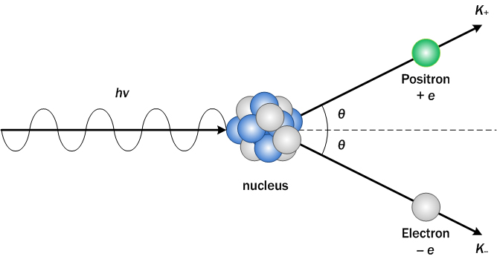
3-Pair production
Here a photon passes by a nucleus and converts to a particle- anti particle pair.
Examples include creating an electron and a positron, a muon and an ant muon, or a proton and an antiproton.

Slide 52
When a very energetic photon enters the intense electric field of the nucleus, it may be converted into two particles: an electron and positron($β$), or positive electron.
Providing the mass for the two particles requires a photon with an energy of at least 1.02 MeV, and the remainder of the energy over 1.02 MeV is given to the particles as kinetic energy.
After it has spent its kinetic energy in ionization it doses a death dance with an electron.

Slide 53
Both then vanish, and their mass energy usually appears as two photons of 511 keV each called annihilation radiation
Pair production is a process in which the energy of a photon is converted into rest mass.
In this process, the photon disappears as an electron-positron pair is created.

Slide 54
Pair Annihilation
Likewise, the energy of an electron-positron pair can be converted into electromagnetic radiation by the process of pair annihilation.
Pair-production is more apt to occur in high Z elements than in low Z elements.
However, two particles must be created. Since the two particles are each other's antiparticle, they have identical masses. So, the total energy required is:
E=2 M C²

Slide 55
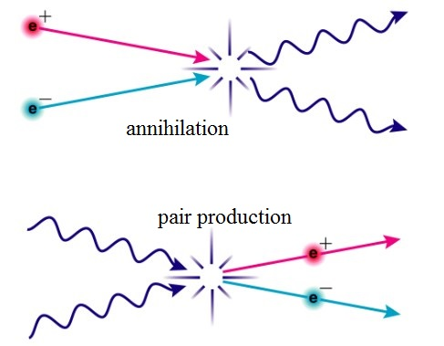

Slide 56
Thank you

